Slide 1
Folkestone & Hythe community engagement meeting
August 2025

Slide 2
Agenda
Introductions
Actions review
Bathing Water analysis
Investigations – What has changed since the last meeting in June
Proactive CCTV and sewer rehab programme
Citizen Science Update
Management of questions group spokesperson
Next meeting dates
Open floor Q and A

Slide 3
Actions review
 | Action log | Owner | Required by | Comments
1 | Orgarswick Avenue care home (Romney Marsh House) will need to be investigated to understand discharge method - | SW | In Progress | Ongoing currently.
2 | Marsh Academy has its own onsite waste treatment process and should be investigated | SW | In Progress | See slide 4
3 | Clarify Hythe outfall usage - Present evidence to confirm which outfall (long sea or short sea) is being used, following concerns about conflicting data on Rivers Trust website: | SW | Complete | Information shared with Sarah on 9th July
4 | Modelling presentation for both outfalls - Present modelling showing how both long and short sea outfalls might affect beaches | SW & F&HC | ongoing | Short sea outfall to be shared. Requested this from our modeller following request, but due to August annual leave we won't receive the animations until September
5 | Follow up on Copperfield estate backup issues - Email response needed regarding whether £184,000 investment will solve effluent backup problems for 6-7 specific properties | SW | Next meeting | See slide 5

Slide 4
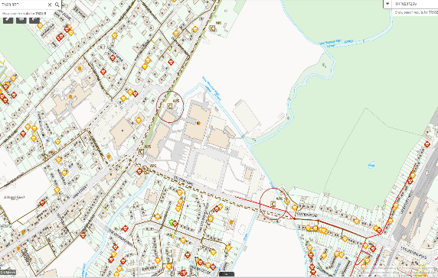
Marsh Academy
Marsh Academy has two wastewater pumping stations located on site, Marsh Academy 1 & 2. located at Northwest and Southeast of the site.
The sites were adopted and now the responsibility of Southern Water

Slide 5
Action 5 - Sewer Improvements Update The Derings Wastewater Pumping Station
Investment:
£184,000 for sewer lining (450m on main 300mm sewer) and planned rising main upgrades
Purpose
Reduce groundwater infiltration into sewer system
Lower risk of effluent backups and flooding for 6-7 affected properties
Improve pumping station capacity during rainfall Benefits:
Seals cracks and stops unwanted water entering the sewers
Reduces flow the station must handle, lowering backup risk
Supports better overall network performance Additional info:
Ongoing catchment investigation continuing
Identified need to reduce surface water entering sewers from customers’ homes (roofs, drives, etc.)

Slide 6
Bathing water analysis

Slide 7
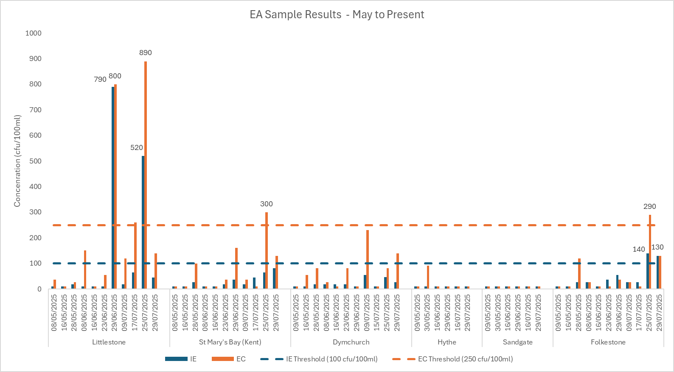
EA Statutory Environmental Monitoring Sample Results (May to Present)
EA BW Sample Results (May – Present)

Slide 8
Elevated results so far..
Littlestone: This site currently remains sitting in ‘Poor’. The headroom to Sufficient is -76%. There have been 3 x elevated results this season
Sample Date/Time | Results (cfu/100ml) | Spill impact (within 5 days prior) | Rainfall (within 5 days prior) | Tidal direction (from) | PRF in place?
29/06/2025 13:41 | 790 IE 800 EC | No spill | Rainfall 27/06 (1.2mm Denge Beach) | South West | No
17/07/2025 14:52 | 64 IE 260 EC | No spill | No rainfall | South/slack | No
25/07/2025 11:43 | 520 IE 890 EC | No spill | Rainfall between 20/07 and 25/07 (33.6mm over 5 day period Denge Beach) | South | No
St Mary’s Bay: This site has a ‘Sufficient’ classification but is currently sitting in ‘Good’ with a headroom of 26%. There has been 1 elevated result this season
Sample Date/Time | Results (cfu/100ml) | Spill impact (within 5 days prior) | Rainfall (within 5 days prior) | Tidal Direction (from) | PFR in place?
25/07/2025 10:18 | 64 IE 300 EC | No spill | Rainfall between 20/07 and 25/07 (45mm over period at Willop) | Slack | No
Folkestone: This site currently remains in ‘Sufficient’, it’s headroom to ‘Good’ is -28% . There have been 2 elevated results this season
Sample Date/Time | Results (cfu/100ml) | Spill impact (within 5 days prior) | Rainfall (within 5 days prior) | Tidal direction (from) | PRF in place?
25/07/2025 10:08 | 140 IE 290 EC | 4 spills. | Rainfall between 20/07 and 25/07 (39mm over period at Cherry Gardens) | Slack | No
 |  | 2 at Folkestone Junct 21/07 16 & 7 mins.
 |  | - 2 at The Stade Folkestone 21/07 3 hrs 29 mins & 23/07 13 hrs 6 mins
29/07/2025 10:58 | 130 IE 130 EC | 1 spill | Rainfall on 24/07 and 25/07 | North East | No
 |  | - The Stade Folkestone 23/07 13 hrs 6 mins
Dymchurch: All sample results are meeting the excellent threshold. Dymchurch is currently remains in it’s poor classification. The headroom to Sufficient is -31%.
Hythe: All results are meeting the excellent threshold. Hythe remains in 'Excellent’ at 43%
Sandgate: All results are meeting the excellent threshold. Sandgate remains in ‘Excellent’ at 52%

Slide 9
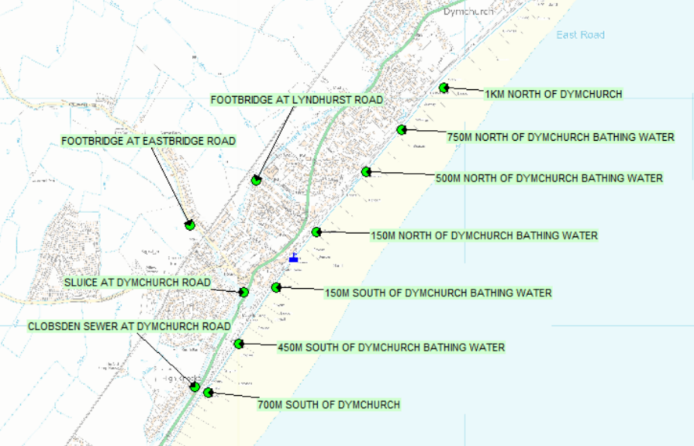
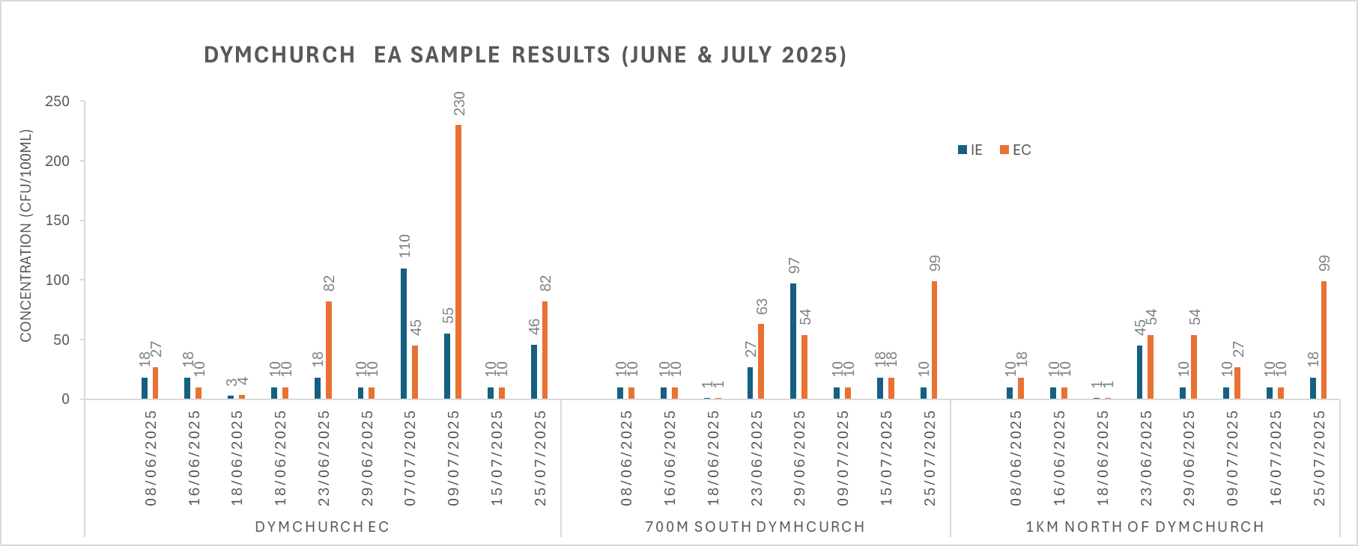
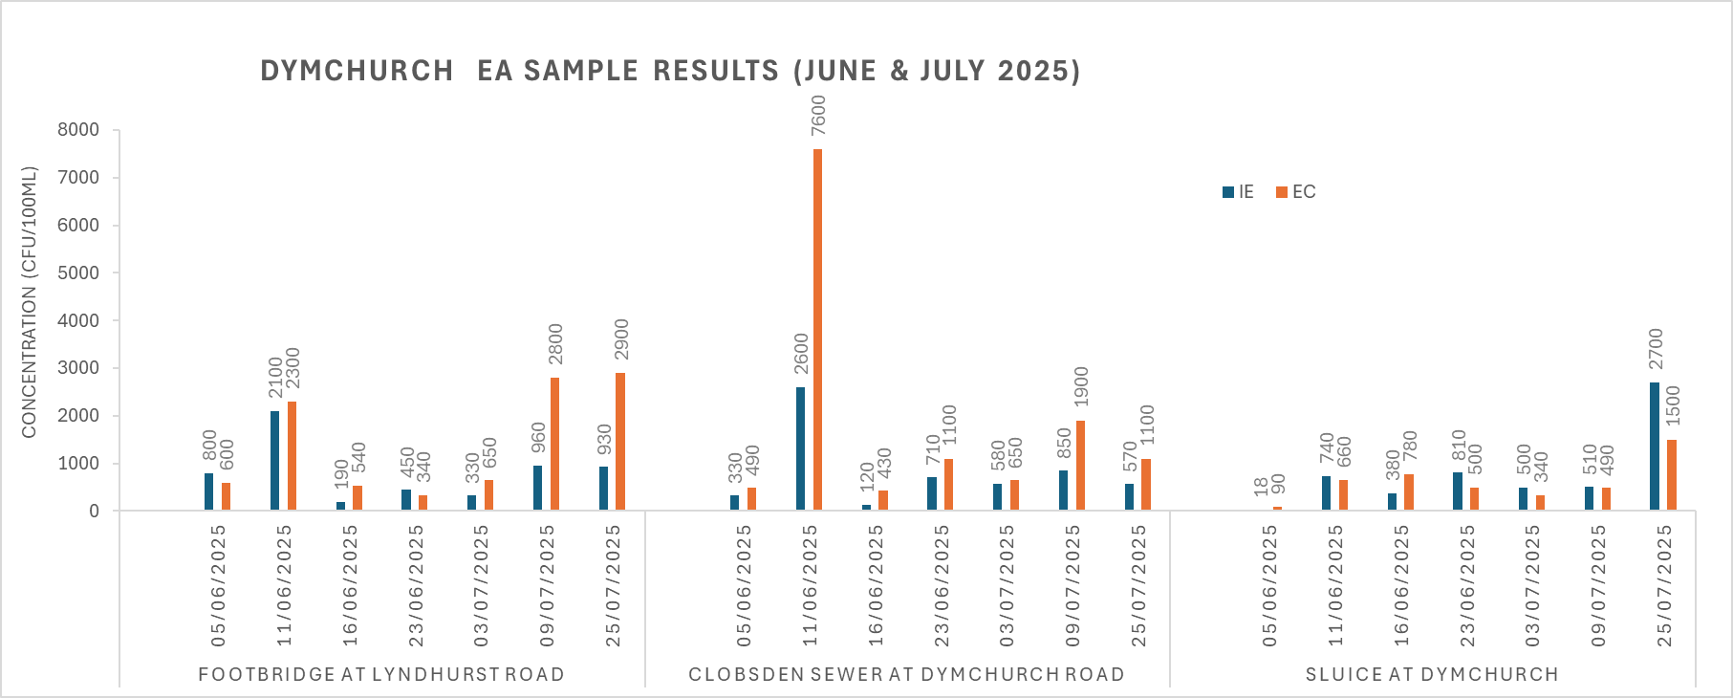
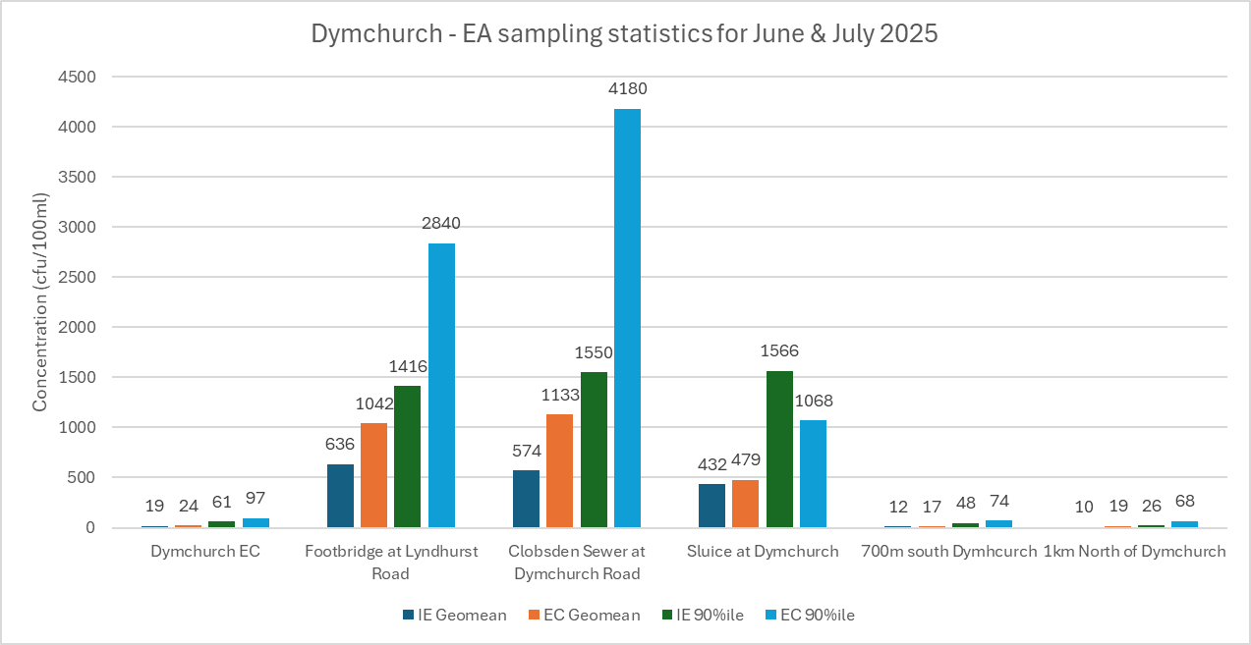
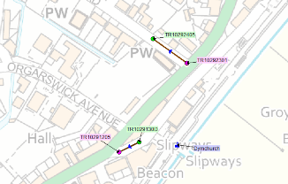
Dymchurch Investigative EA Sample Data
The elevated E. coli result at Clobsden Sewer on 11/06 could be related to the 15 mm of rainfall on 07/06 (Willop), a defective sewer has also been discovered at the bottom of Chapel road, this is potentially exfiltrating into the surface water sewer which runs along The Highstreet and into the Sluice and Clobsden Sewer. The defective sewer is at close proximity to the BW sampling point

Slide 10
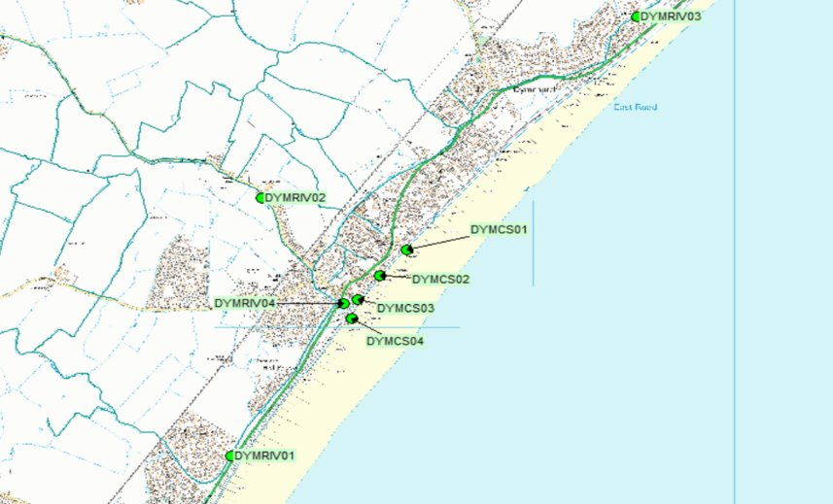
Dymchurch Shadow Sampling Data
​
2025 Summary​
55 samples collected.
8 Coastal samples and 4 Outfall samples are above the ‘Excellent’ threshold.
Sampling will continue throughout 2025
Sample number | Date | Weather | Time collected | Water Temp | Tide | Flow in outfall | Bottled sample ref | Ecoli result | IE results | Above Excellent?
DYMCS02-02 | 06/02/2025 | Light rain | 12:43 | 5 | Mid low tide | Yes | 8810085 | 300 | 68 | Yes
DYMCS02-09 | 19/06/2025 | Sunny | 10:22 | 18 | Low tide | Yes | 9061784 | 140 | 410 | Yes
DYMCS02-11 | 15/07/2025 | Sunny | 09:52 | 16 | Low tide | Yes | 9114700 | 100 | 140 | Yes
DYMCS03-11 | 15/07/2025 | Sunny | 09:59 | 16 | Low tide | Yes | 9114701 | 900 | 1000 | Yes
DYMCS04-02 | 06/02/2025 | Light rain | 12:26 | 5 | Mid low tide | Yes | 8810087 | 100 | 500 | Yes
DYMCS04-09 | 19/06/2025 | Sunny | 09:57 | 18 | Low tide | Yes | 9061783 | 300 | 28 | Yes
DYMCS04-10 | 20/06/2025 | Sunny | 12:43 | 19 | Low tide | Yes | 9030391 | 200 | 200 | Yes
DYMCS04-11 | 15/07/2025 | Sunny | 10:02 | 16 | Low tide | Yes | 9114702 | 700 | 350 | Yes
DYMCS04-O-02 | 06/02/2025 | Light rain | 12:31 | 5 | Mid low tide | Yes | 8810088 | 430 | 530 | Yes
DYMCS04-O-09 | 19/06/2025 | Sunny | 10:10 | 18 | Low tide | Yes | 9061782 | 2000 | 440 | Yes
DYMCS04-O-10 | 20/06/2025 | Sunny | 12:55 | 19 | Low tide | Yes | 9030390 | 1300 | 780 | Yes
DYMCS04-O-11 | 15/07/2025 | Sunny | 10:08 | 16 | Low tide | Yes | 9114703 | 4600 | 1400 | Yes

Slide 11
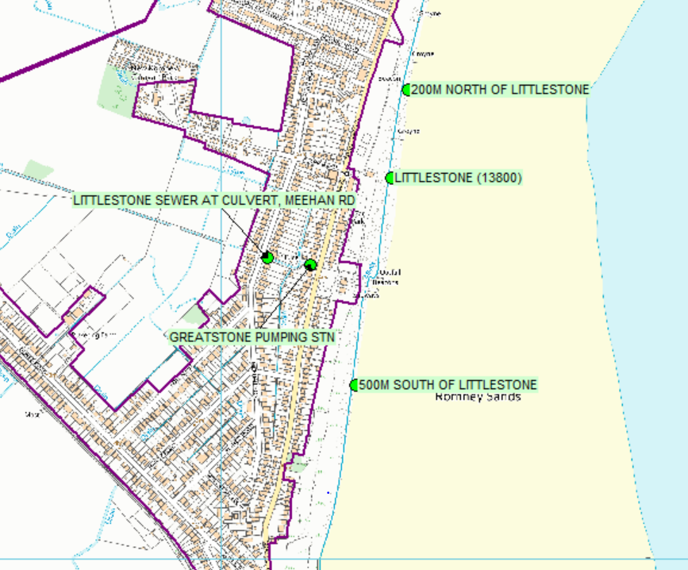
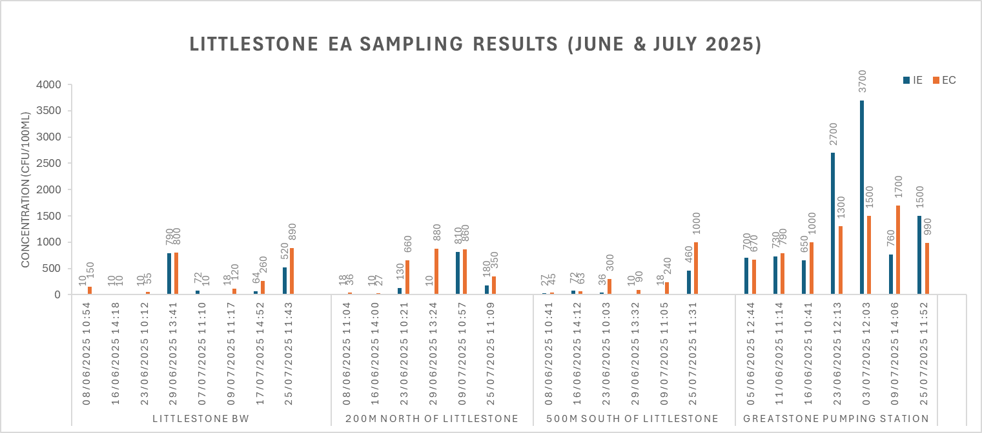
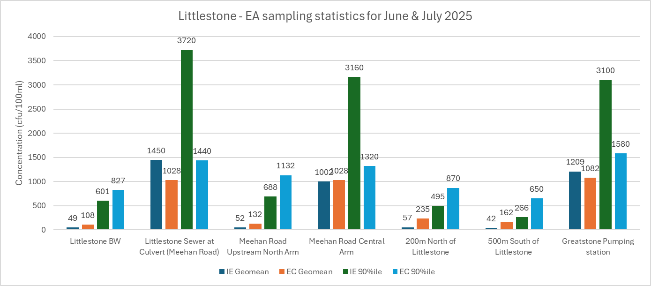
Littlestone Investigative EA Sample Data
Contaminant sources at Littlestone Sewer at Culvert and Greatstone Pumping Station could be from several unlined cesspits in the area,
The elevated concentration at Greatstone Pumping Station (3rd July) does not appear to be linked to rainfall

Slide 12
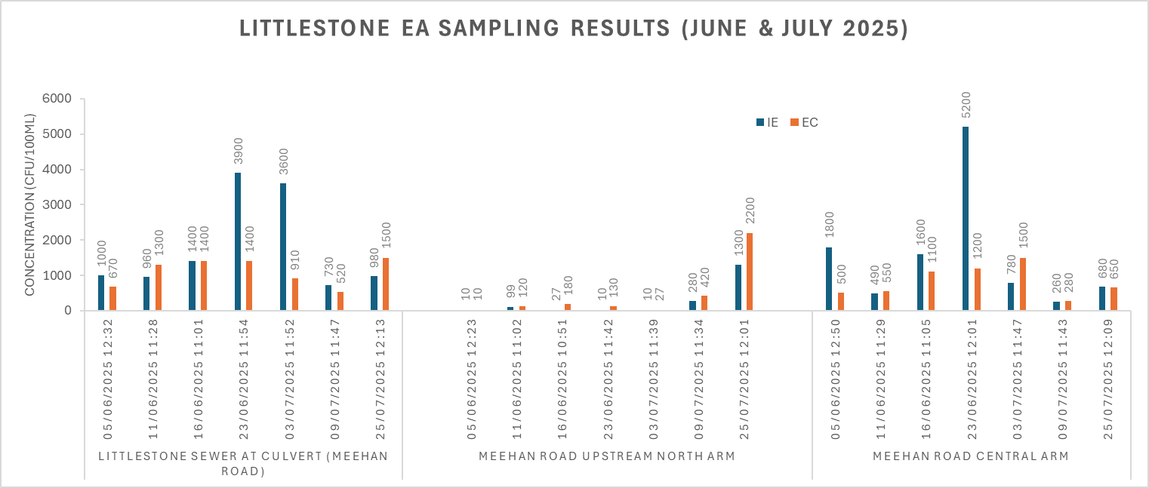
Littlestone Investigative EA sample Data 2
The elevated results at Littlestone Sewer and Meehan Road Central Arm do not appear to be associated with rain in these instances

Slide 13
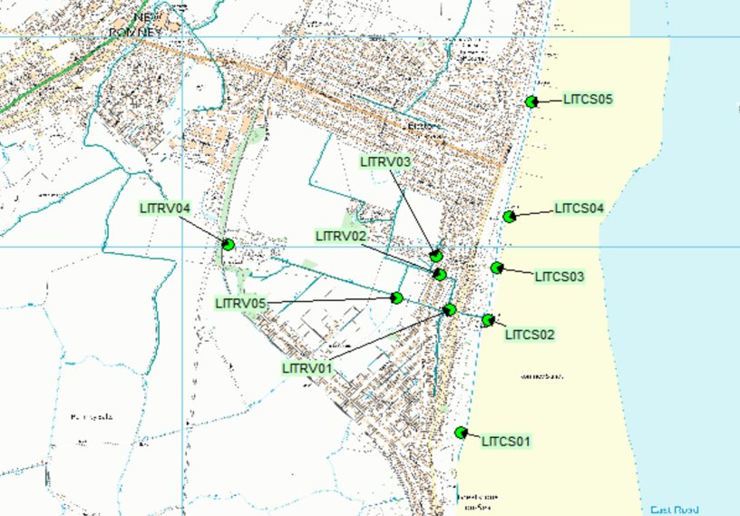
Littlestone Shadow Sample Data
2025 Sampling Summary​
50 samples collected.
7 coastal samples above ‘Excellent’ threshold
Sampling will continue throughout 2025
Sample number | Date | Weather | Time collected | Water Temp | Tide | Flow in outfall | Bottled sample ref | Ecoli result | IE results | Above Excellent?
LITCS01-01 | 13/01/2025 | Sunny | 12:14 | 4.5 | High tide | Yes | 8761848 | 290 | 280 | Yes
LITCS01-02 | 31/01/2025 | Light rain | 12:03 | 6 | High tide | Yes | 8796773 | 70 | 180 | Yes
LITCS02-02 | 31/01/2025 | Light rain | 11:33 | 6 | High tide | Yes | 8796774 | 300 | 290 | Yes
LITCS02-06 | 14/03/2025 | Sunny | 09:42 | 11 | High tide | No | 8879350 | 170 | 48 | Yes
LITCS03-01 | 13/01/2025 | Sunny | 11:16 | 4.5 | High tide | Yes | 8761850 | 1100 | 130 | Yes
LITCS04-07 | 09/06/2025 | Dry | 10:39 | 10 | Mid high tide | No | 9042562 | 300 | 45 | Yes
LITCS05-02 | 31/01/2025 | Light rain | 10:55 | 5 | High tide | Yes | 8796777 | 100 | 120 | Yes

Slide 14
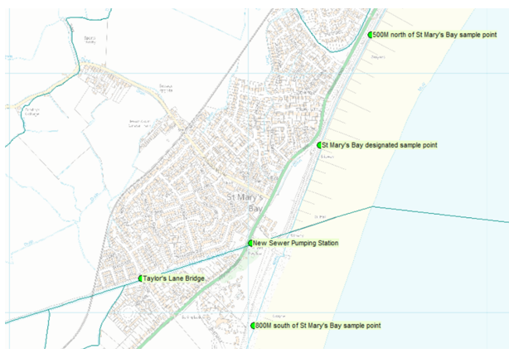
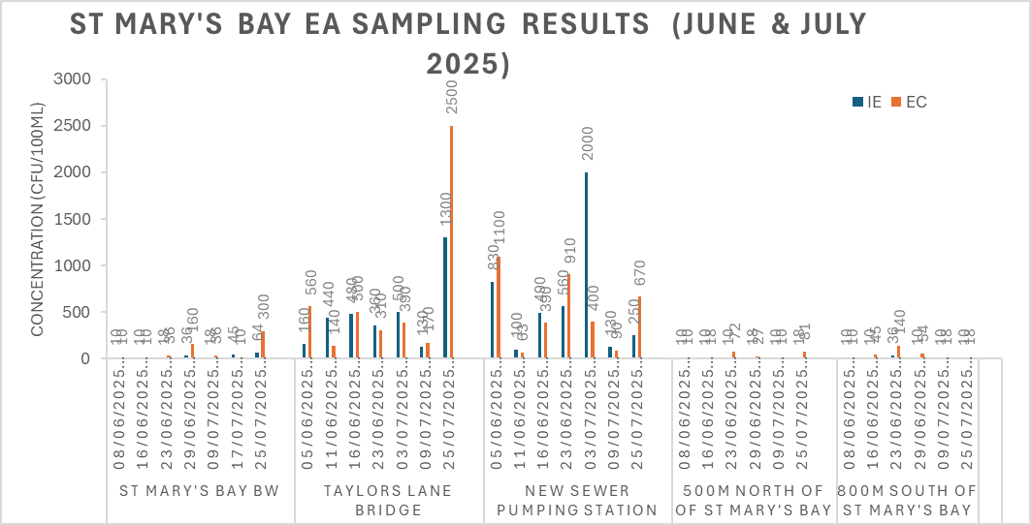
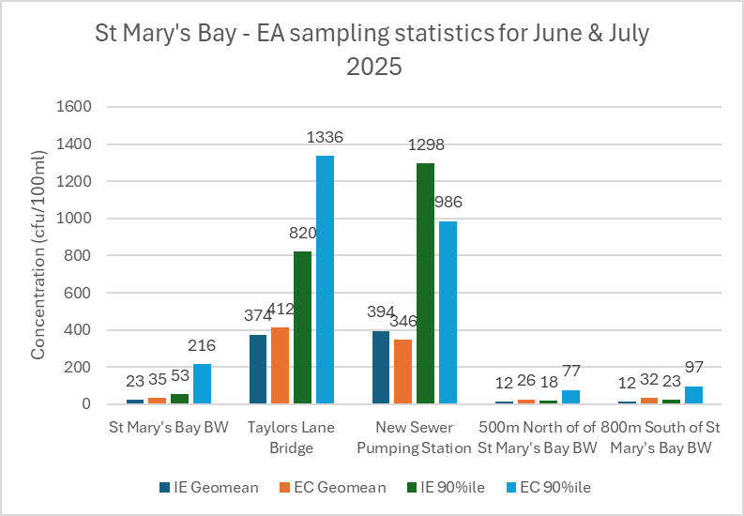
St Mary’s Bay Investigative EA Sample data
The elevated result at Taylors Lane Bridge on 25th July is likely associated with the significant rainfall which occurred between the 18th and 22nd July
The elevated result at New Sewer Pumping Station on the 3rd July could be linked to rainfall on 2nd July

Slide 15
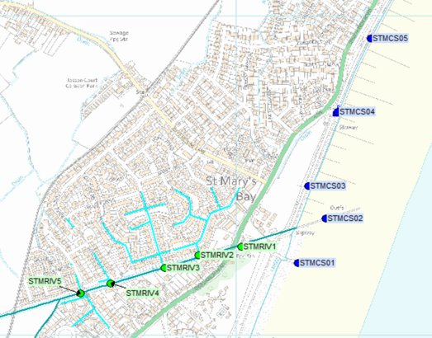
St Mary’s Bay Shadow Sample data
2025 Summary:
77 samples collected.
9 Coastal sample above the ‘Excellent’ threshold.
Sampling will continue throughout 2025
Sample number | Date | Weather | Time collected | Water Temp | Tide | Flow in outfall | Bottled sample ref | Ecoli result | IE results | Above Excellent
STMCS01-04 | 14/02/2025 | Sunny | 11:08 | 4.5 | High tide | No | 8823954 | 40 | 140 | Yes
STMCS01-06 | 07/03/2025 | Sunny | 10:52 | 9 | Low tide | Yes | 8863886 | 50 | 130 | Yes
STMCS01-08 | 21/03/2025 | Dry | 10:39 | 10 | Mid low tide | Yes | 8892579 | 200 | 30 | Yes
STMCS01-10 | 01/08/2025 | Sunny | 12:45 | 16 | Mid low tide | Yes | 9149826 | 410 | 1000 | Yes
STMCS02-08 | 21/03/2025 | Dry | 10:31 | 10 | Mid low tide | Yes | 8892580 | 150 | 320 | Yes
STMCS02-10 | 01/08/2025 | Sunny | 12:48 | 16 | Mid low tide | Yes | 9149827 | 560 | 450 | Yes
STMCS03-10 | 01/08/2025 | Sunny | 12:51 | 16 | Mid low tide | Yes | 9149828 | 200 | 510 | Yes
STMCS04-04 | 14/02/2025 | Sunny | 11:25 | 4.5 | High tide | No | 8823957 | 200 | 120 | Yes
STMCS05-02 | 30/01/2025 | Dry | 12:01 | 6 | High tide | Yes | 8794401 | 600 | 51 | Yes

Slide 16
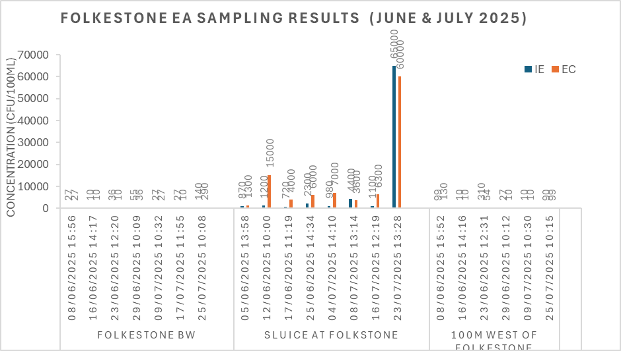
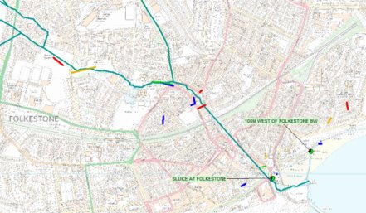
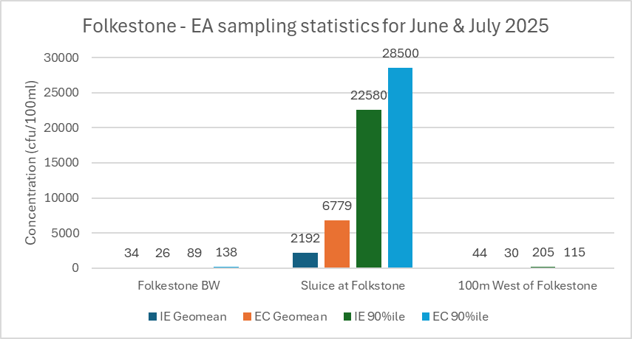
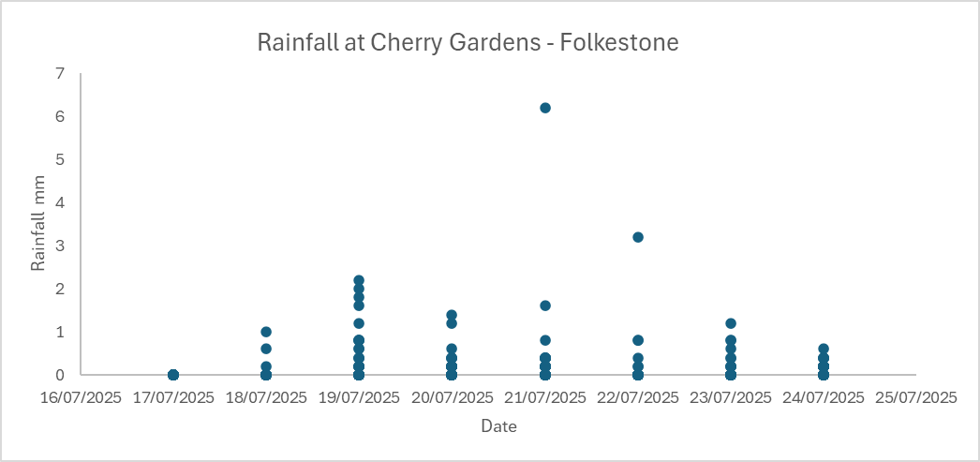
Folkestone Investigative EA Sample Data
We are still working in the Pent Stream catchment to track down misconnections and possible defective sewers. A high scoring defective sewer was found upstream from the Pent Stream during the recent sewer CCTV work – shown in red on the map.
Sampling at the Sluice at Folkestone shows one very high concentration result (on 23rd of July) This is likely associated with significant rainfall which occurred between 17/07 and 23/07.

Slide 17
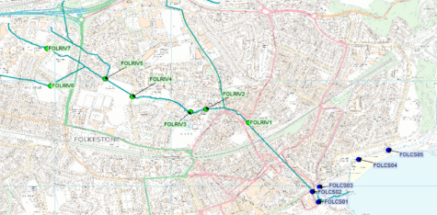
Folkestone Shadow sampling results
2025 Summary
92 Samples collected
8 Coastal sample below ‘Excellent’ threshold – nothing new since last meeting
3 Inland river samples above 10,000 E.coli / 100ml
Sampling will continue throughout 2025
Sample number | Date | Weather | Time collected | Water Temp | Tide | Flow in outfall | Bottled sample ref | Ecoli result | IE results | Above Excellent?
FOLRIV1-04 | 12/02/2025 | Dry | 11:06 | 7.5 | High | No | 8819695 | 30 | 10000 | Yes
FOLRIV1-05 | 27/02/2025 | Dry | 10:49 | 7.5 | High tide | No | 8847105 | 10000 | 1400 | Yes
FOLRIV3-05 | 27/02/2025 | Dry | 12:12 | 8.5 | High tide | No | 8847107 | 10000 | 1300 | Yes
FOLCS01-05 | 27/02/2025 | Dry | 11:14 | 7.5 | High tide | No | 8847100 | 100 | 140 | Yes
FOLCS01-10 | 15/05/2025 | Sunny | 12:32 | 13.5 | High tide | No | 8996962 | 400 | 690 | Yes
FOLCS02†-05 | 27/02/2025 | Dry | 11:17 | 7.5 | High tide | No | 8847101 | 100 | 110 | Yes
FOLCS02†-07 | 17/03/2025 | Sunny | 12:34 | 8 | High tide | No | 8884581 | 100 | 500 | Yes
FOLCS02†-10 | 15/05/2025 | Sunny | 12:26 | 13.5 | High tide | No | 8996963 | 200 | 180 | Yes
FOLCS04-03 | 03/02/2025 | Dry | 12:13 | 9 | Low | No | 8802508 | 100 | 260 | Yes
FOLCS04-04 | 12/02/2025 | Dry | 11:52 | 7 | High | No | 8819702 | 21 | 190 | Yes
FOLCS04-05 | 27/02/2025 | Dry | 11:31 | 7.5 | High tide | No | 8847103 | 40 | 180 | Yes

Slide 18
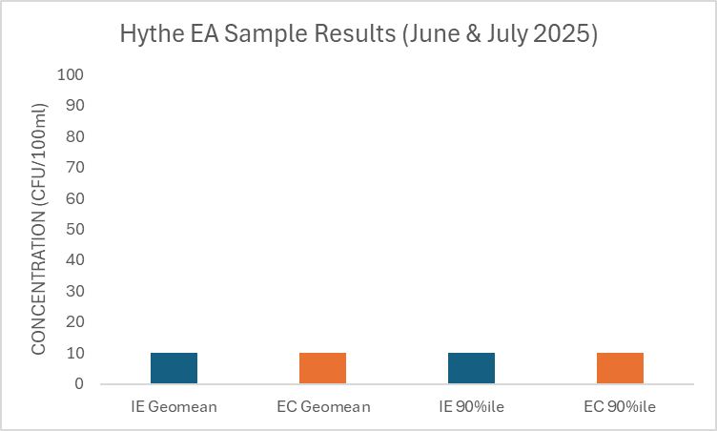
Hythe sample data

Slide 19
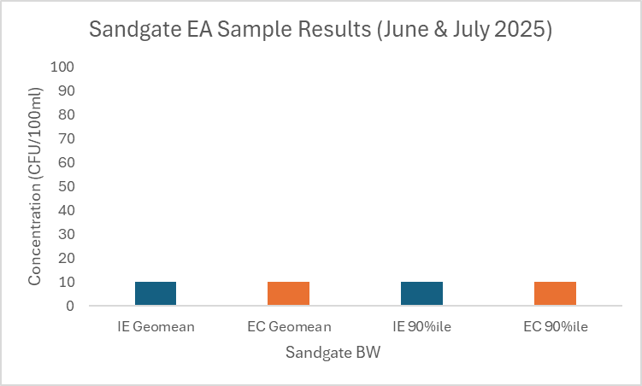
Sandgate sample data

Slide 20
Bathing Water investigations

Slide 21
Investigation highlights
Dymchurch WTW improvements. Samples collected from the final effluent, have shown a consistent improvement in bacteria and solids removal. A reduction has been 95% observed post UV treatment.
Electro-scan survey completed on foul system in the Sea Wall area if Dymchurch. The report suggests there are areas that exfiltration could occur. Work orders raised to reline sewers
Investigations in the Pent stream, Folkestone have identified 3 illegally connected properties identified, including a toilet misconnection.
Sewer rehab work has started in Folkestone. See slide 22
CCTV investigations have identified sewers that require remediation
Continued monitoring of Littlestone and St Mary’s Bay
Continued collaboration with Folkestone & Hythe council and Environment Agency

Slide 22

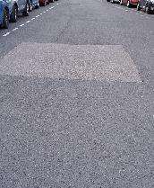
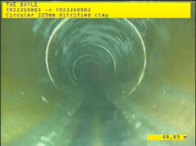
Bathing water Sewer rehab
Further analysis to the remediation list, factoring in priority, number of defect, pathway to bathing water.
All permits for repairs have been submitted
Negotiations to start with local Authority to avoid saturation
The Bayle, Folkestone work already complete
“Following CCTV inspection works from node TR22359802X, it has now been confirmed that a previous repair has already been completed at this location, and no faults have been found”.

Slide 23
Bathing water investigations Folkestone & Hythe
Dymchurch
St Mary’s Bay
Illegal Connections survey of the surface water catchment completed in 2024​
Sewer lining complete on domestic property, Lyndhurst Road​
5 wrongly connected properties identified between 2020 and 2023​
Holiday Parks drainage checked​
Sediment sampling completed in the river​
Dymchurch WTW improvements
CCTV to be undertaken of foul sewers​​
Electroscan survey complete in the Sea wall catchment
Illegal Connections survey of the surface water catchment completed
5 wrongly connected properties identified between 2019 and 2023
Rising main from Taylor’s Lane WPS pressure tested to identify any leaks – none found
APEM investigations – Catchment study completed (including sediment sample taken from the New Sewer)
Sewer lining has taken place
Ongoing monitoring of the New Sewer
Folkestone – Sunny Sands
Illegal Connections team survey of the surface water catchment ongoing.​
3 properties identified having household waste connected to the surface water system. 2 resolved, toilet connection remains outstanding
Sewer rehabilitation has started. Repair complete in The Bayle, Folkestone
Littlestone
Illegal Connections team monitoring continues​
3 domestic properties on Cess pits connected to mains drainage but there are others that are not willing to connect
Working with Folkestone & Hythe council to progress
Plan in development to focus attention on the ground investigations
23
23
Notes:
Read more in the bathing water report

Slide 24
Citizen Science
Alex Finch – Water Quality Specialist

Slide 25
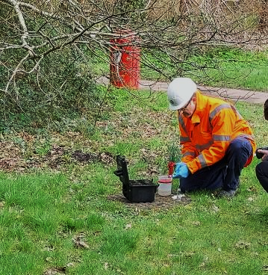
Update on Citizen Science
Facilitated through University of Surrey
Water Quality Monitoring: Intensive sampling at four Folkestone bathing waters, both in and outside the bathing season (Daily – Resource Depending).
Catchment Surveys: Citizen science engagement through local surveys for context & to identify pollution risks.
Verification Sampling: Independent lab testing alongside Environment Agency samples to ensure data integrity.
Optional Pollution Tracing: Additional chemical/microbiological analysis available to pinpoint pollution sources as needed (e.g eDNA/bacteriophage)

Slide 26
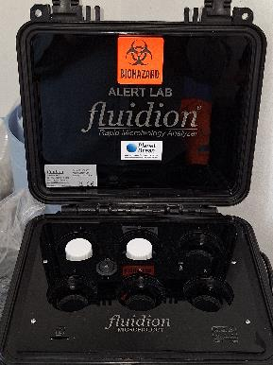
Citizen Science Testing
Rapid Micro
Fluidion – ALERT LAB
Result in <=14 hours (48+ Lab)
6 simultaneous sample slots
FIB/FIO – E.Coli – BW regs
Reduced cost comparative to traditional laboratory sampling
Does not provide information on source of pollution.
Only microbiological data – Physical/Chemical parameters

Slide 27
Citizen Science Programme Development
Start Date?
Time requirements to mobilise?
Suitable location for delivery and store of equipment?
Number of participants – (Paired working)?

Slide 28
Management of group questions and group spokesperson
Designate a Group Spokesperson: Assign a person from the group to act as the official spokesperson to streamline communication.
Centralise Question Submission: All group questions should be collected and filtered through the spokesperson before being presented to the Stakeholder Manager Mike Russell.
Provide Feedback Summary: After the meeting, spokesperson should summarise responses and feedback to share with their group members.
Limit Number of Questions: The spokesperson should prioritise and consolidate questions to avoid repetition and manage time effectively.
The group spokesperson coordinates questions outside of main discussion times, but this doesn’t replace the opportunity for anyone to ask questions directly during the meeting.

Slide 29
Next meeting dates
We would be delighted to host this meeting at one of your venues. Please let us know if you require a projector, we would be happy to provide one to support the presentation.
Next meeting dates :
Tuesday 11th November 10am – 12:15
Tuesday 10th February 10am -12: 15

Slide 30
Questions and Answers session open floor

