Slide 1
Folkestone & Hythe community engagement meeting
February 2026

Slide 2
Agenda
Introductions
Actions review
Littlestone update
APEM Sampling Programme
Engagement
Investigations – What has changed since the last meeting in August

Slide 3
Actions review
 | Action log | Owner | Required by | Comments
1 | Check if Hythe overflow events are linked to high results | AS/SR | Completed
2 | Provide more detail on the spill model (spill length and wind direction) | AS | Complete
3 | Confirm position, cost, and timing for UV at New Romney | PCN | Ongoing

Slide 4
Action 1: Impact of Hythe Overflows of Bathing Water Samples 1
Analysis was carried on all bathing water samples collected between 2021 and the end of 2025 at all designated sample sites in the Folkestone and Hythe area. A total of 570 samples.
The E.coli and intestinal enterococci concentrations of the samples were correlated with number of days which had passed since overflows had operated at Range Road Long Sea Outfall and Range Road Short Sea Outfall.
If overflows were to be impacting on sample concentrations, then a negative correlation would be expected between the number of days which have elapsed between the overflow operation and sample collection.
The results of these analyses are presented overleaf.

Slide 5
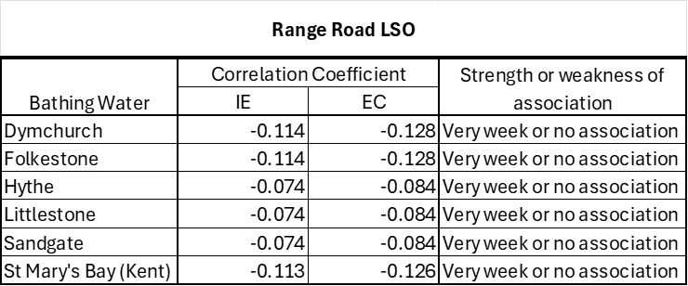
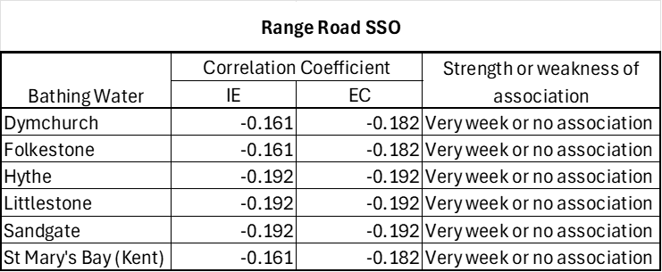
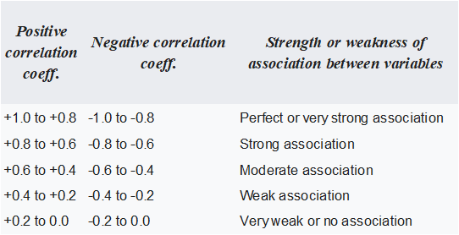
Action 1: Impact of Hythe Overflows of Bathing Water Samples 2
These results indicate in all cases "Very weak or no association".
A guide to interpreting correlation coefficients is provided below.

Slide 6
Provide more detail on the spill model (spill length and wind direction) Action 2
Spill durations modelled: 1, 3, 12 and 25 hours
Tidal states included: HW Neap, HW Spring, LW Neap, LW Spring
Creates 12 tidal scenarios per outfall → around 2,000 models in Rivers & Seas Watch
25‑hour spills and onshore wind conditions are included in Rivers & Seas Watch
Published documentation is slightly out of date and will be updated when real‑time tidal modelling goes live later this year.

Slide 7
Confirm position, cost, and timing for UV at New Romney Action 3
Where We Are Now
Trojan has assessed the site and given us three design options for a new UV system.
A new system means moving to a new UV permit based on validation dosing.
The permit level will be set after long‑term sampling of bacteria levels and how well the UV kills them.
Once the sampling and calculations are done, we’ll know what the new permit limits will be.
Timeframe
The aim is to have the new system installed within the next 3 years.
This target has been repeated on several calls and is our working expectation.
Cost
New UV system: around £7 million
With civil works included: around £8.5 million (could increase depending on final design).

Slide 8
Littlestone Focus

Slide 9
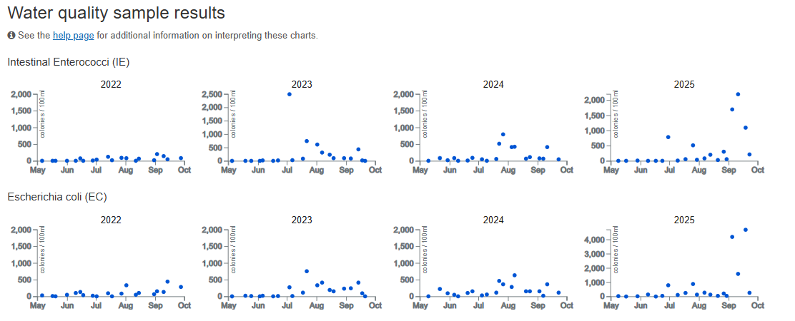
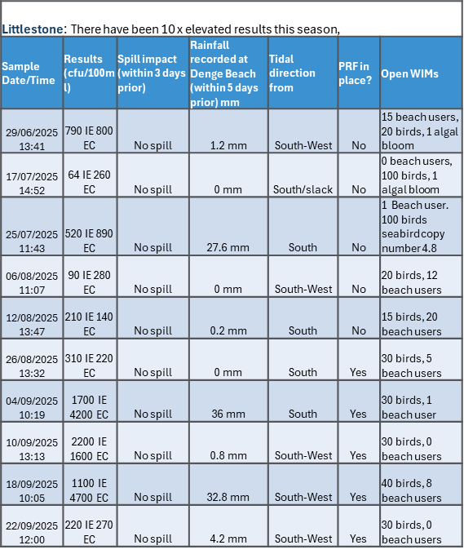
Background
Littlestone-on-Sea is a resort beach in the middle of a 20 kilometre (km) stretch of beach in Hythe Bay, Kent. Hythe Bay stretches from Folkestone down to the headland of Dungeness.
EA classifications has decline in bathing water from ‘Good’ status in 2022 to ‘Poor’ in 2023, 2024, 2025
Littlestone continued to see elevated samples in 2025 where other ‘Poor’ areas have improved
Headroom to improve to Sufficient is -150%
All high samples were detected during a South to North tidal conditions
There is a weak-positive relationship with rainfall and high samples,
There were no overflow events in association with high samples

Slide 10
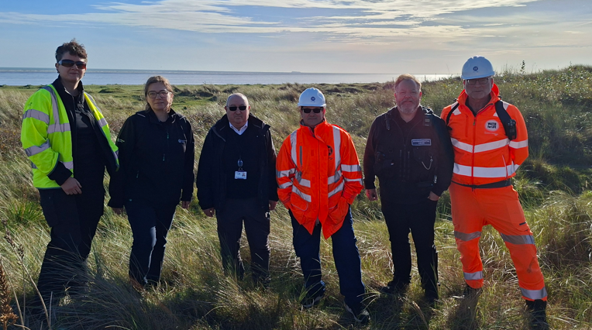
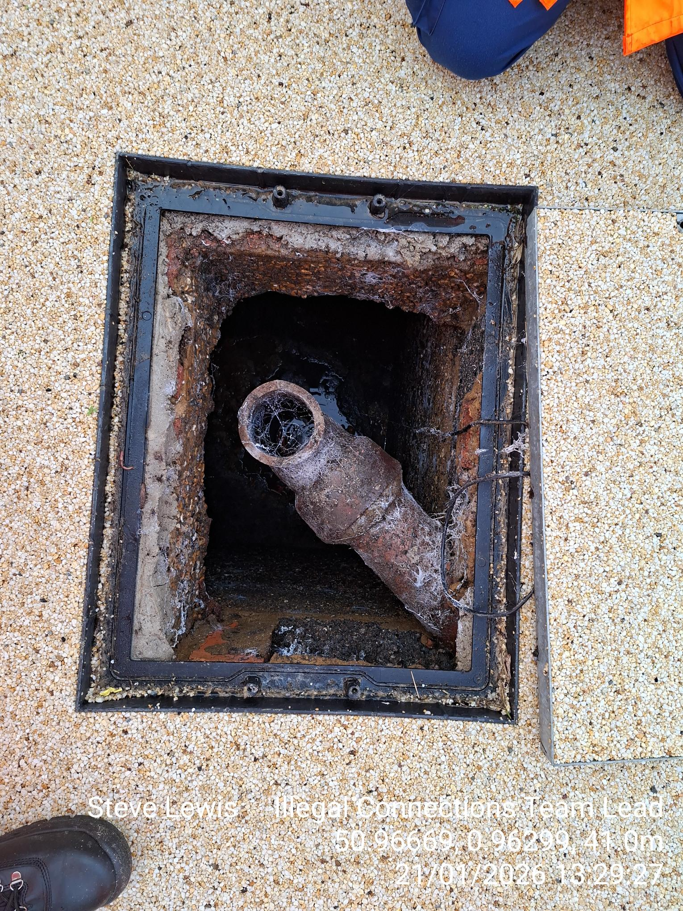
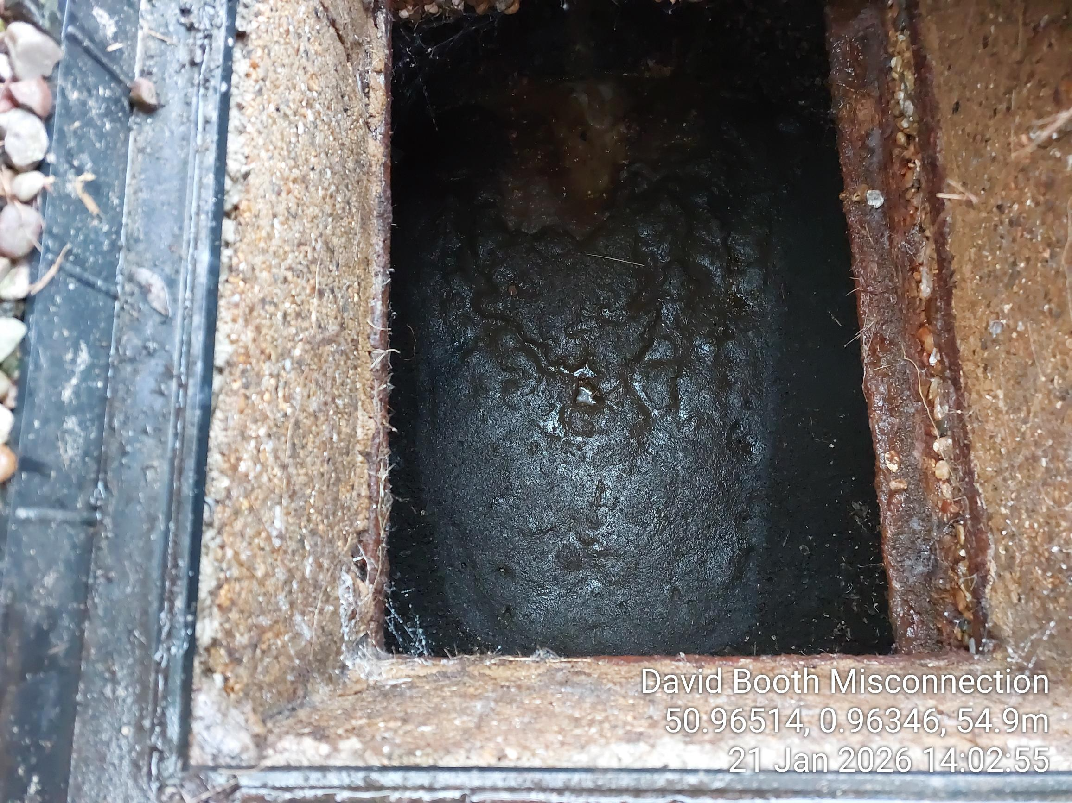
Unconnected properties
Four properties with defective Cess pits connected to mains drainage
Ongoing efforts to resolve 3 outstanding properties on Coast Drive and Mehan road unsuccessful despite regular visits by SWS, FHDC & EA
Had a joint meet with EA / LA and SW to visit properties
What’s next?
400 unconnected properties identified in Greatstone
49 properties are high risk due to location. The Parade will be our primary focus
Infrastructure is in place to connect more properties
Door knock completed 21/01 FHDC and found not many people home
FHDC will work to identify second homes and arrange a letter drop

Slide 11
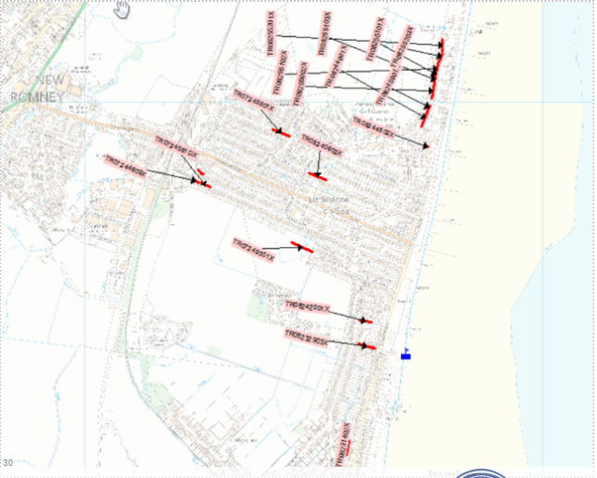
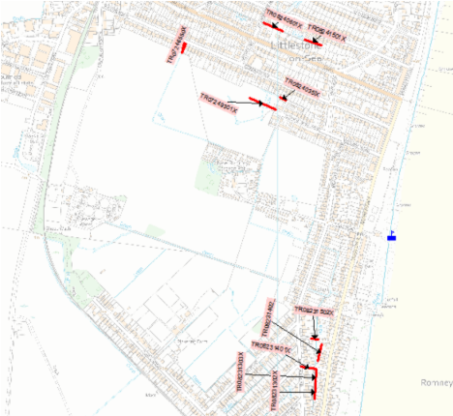
Sewer investigations and rehab plan
Analysis of existing CCTV was carried out identified a number of issues. It is not clear whether these issues have been addressed. These areas will be re-surveyed
Proposed additional CCTV planned to investigate high-risk sewers that could impact bathing water quality.
A list of all locations has been shared with Cappagh Browne and a quote is immanent.
Instructions given to start at the earliest opportunity
A zero-tolerance approach will be adopted, ensuring all issues are fixed to an optimal level to negate future repeat issues
Existing CCTV – potential issues
Proposed additional CCTV

Slide 12
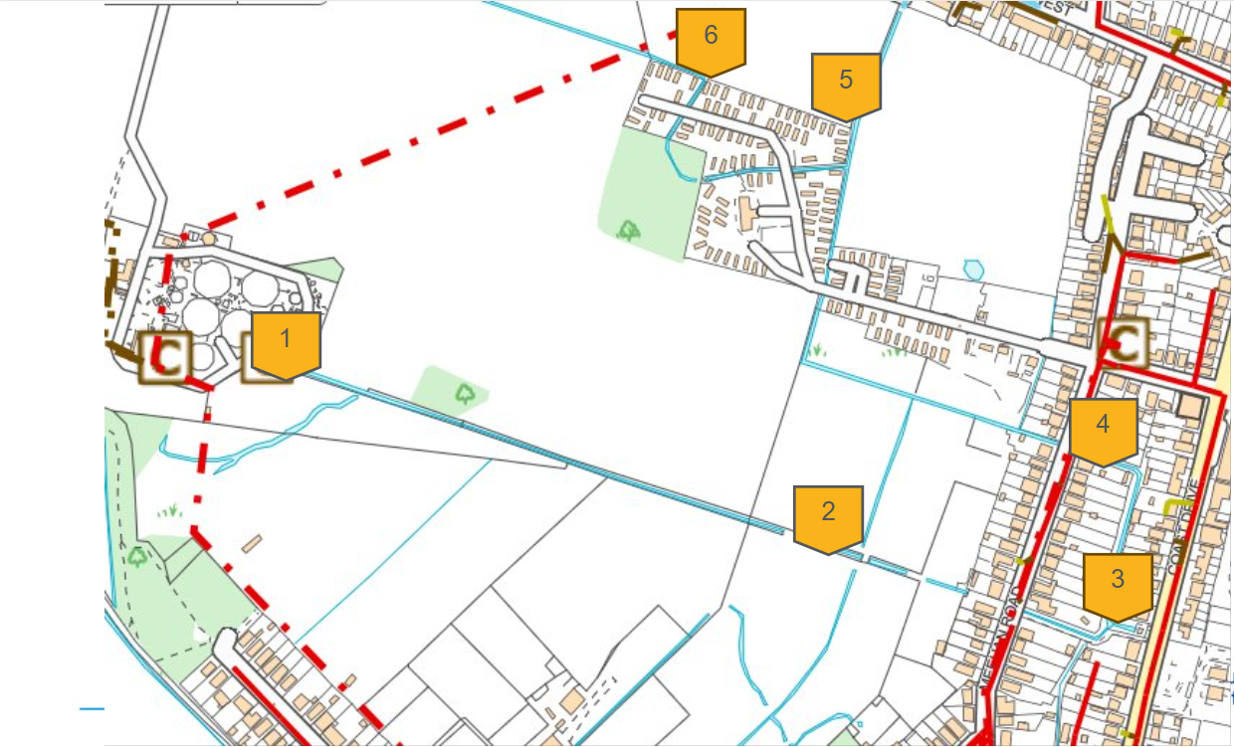
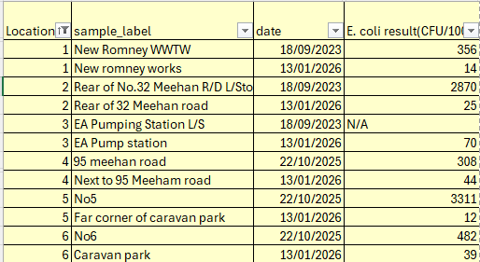
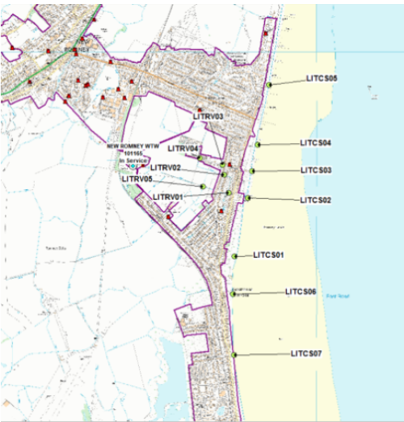
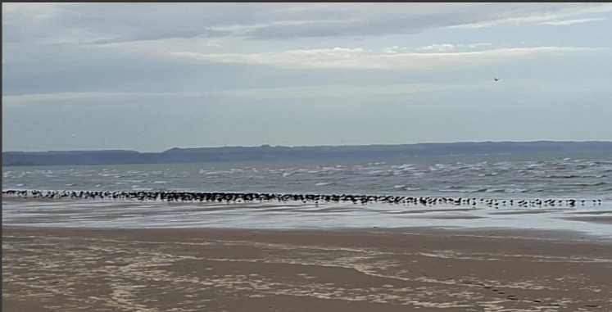
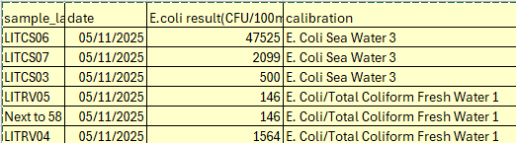
Illegal Connections
Initial AMP 7 improvement plan completed 2023 Included dye testing from WWTW / walkover/ lift and look/ Caging
Cess pits inspections carried out and to be continued
Currently checking water courses that feed into EA Sampling point, and surrounding watercourses
New Improvement plan to commence Feb 26 and will replicate the AMP7 improvement plan
Ongoing monitoring throughout the bathing season
Collaborate with external stakeholders and conduct regular site visits
Work with the wider business for opportunities to share local knowledge support with improvements

Slide 13
APEM Sampling Programme

Slide 14
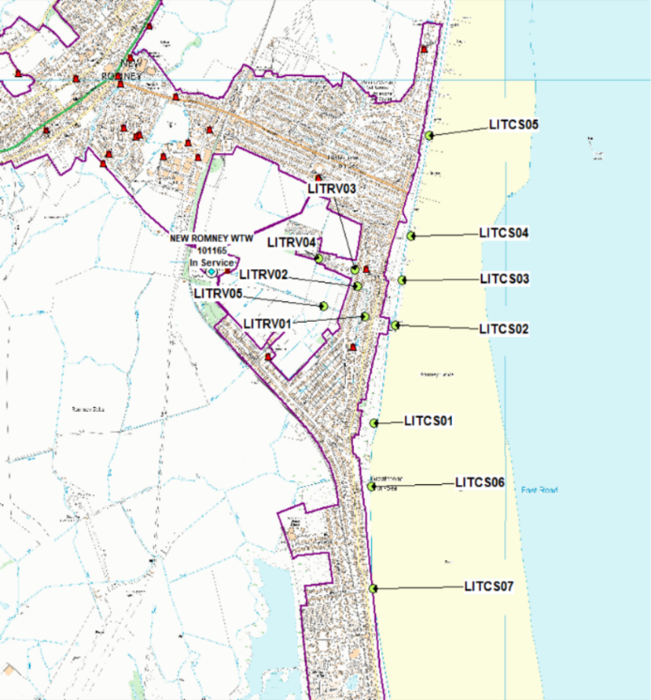
Sampling Programme Design
Study Purpose
Identify likely contamination sources and pathways
Provide evidence to inform next-phase decisions
Targeted, proportionate, and adaptable by design
Programme design
Initial 10-day intensive programme
Designed to target and justify any follow-on sampling, including key bathing season periods
Scalable based on findings, phase two is expected
Spatial coverage & Variation
12 locations in total (7 coastal sites, 5 inland pathways)
Spring and neap (5 days each)
Sediment cores at all coastal sites (2 core transect at LITCS01 & 06)
Notes:
This is a targeted and proportionate sampling programme — the focus here is on generating evidence, not just collecting data.
Start time of this programme is as soon as practical.
The overall aim is to understand where contamination might be coming from and how it’s reaching Littlestone bathing waters.
We’ve set this up as an initial ten-day intensive programme. The idea isn’t to do everything at once, but to get a strong evidence base that lets us decide, with confidence, how we can expand the sampling.
In terms of coverage, we’re looking at both the coastline and the inland pathways, with 7 coastal site and 5 inland sites. That’s important because bathing water quality here is influenced by a mix of marine conditions and freshwater inputs.
We’re also building in variability by sampling across spring and neap tides, and across wet and dry weather where possible.
And finally, we’re including sediment core sampling at all the coastal sites. That helps us understand whether contamination might be sitting in the sediments and getting re-released, rather than assuming it’s all coming from active or recent sources.

Slide 15
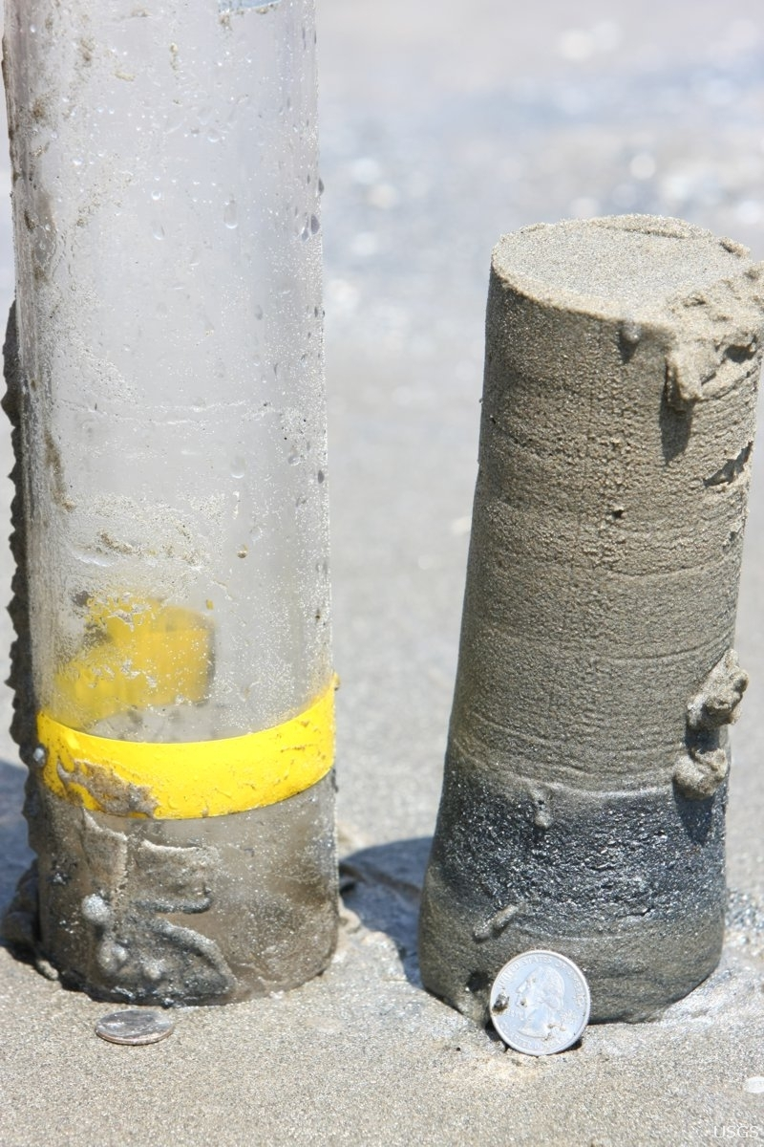
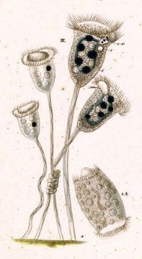
Analysis Framework and Evidence Logic
Each parameter is selected to identify sources, persistence and re-suspension of contamination across water and sediment
Interpretation accounts for tidal state (spring/neap) and wet/dry weather conditions
Parameter | Sample type | → What it tells us
E. coli | Coastal & Inland water | Presence and strength of faecal contamination
Enterococci | Coastal & Inland water | Persistence and sewage-related influence
Salinity | Coastal & Inland water | Freshwater vs marine influence
Temperature | Coastal & Inland water | Conditions affecting bacterial persistence & freshwater influence in coastal waters
Ammonia | Inland water | Recent sewage or wastewater inputs
Total phosphorus | Inland water | Nutrient enrichment and source type
Turbidity | Inland water | Sediment mobilisation and re-suspension
Sediment FIB | Sediment cores (top, middle, bottom) | Stored or long-term contamination
Particle size distribution | Sediment cores (top, middle, bottom) | Likelihood of bacterial retention/release
Protozoa (eDNA) | Sediment cores (top, middle, bottom) | Biofilm and bacterial re-release potential
Beach sediment core example (image from usgs.gov)
Outputs
Interpreted water and sediment dataset
Full report of findings and conclusions will be produced by experts at APEM
Identification of likely contamination sources and pathways
Evidence to inform our investigations and interventions
Protozoa: Vorticella
(C.G. Ehrenberg illustration)
Notes:
This slide is really about the logic behind the analysis — every parameter is there for a reason.
The faecal indicator bacteria tell us whether contamination is present and how strong it is. Looking at both E. coli and enterococci also helps us understand how persistent that contamination might be and whether sewage influence is likely.
Salinity and temperature give us important context. They help us separate freshwater inputs from marine influence and understand conditions that affect how long bacteria can survive.
Turbidity is useful because it gives us an indication of sediment movement. When turbidity is high, that can mean fine sediments are being re-suspended, which in turn can release bacteria back into the water.
At inland sites, ammonia and total phosphorus help us pick up recent wastewater inputs and distinguish point sources from more diffuse nutrient enrichment.
The sediment work is really key. Faecal indicators at different depths tell us whether contamination is being stored over time. Particle size analysis helps us understand how likely sediments are to hold onto bacteria or release them — especially where fine silts are present, as these have a high surface-area-to-volume ratio.
We’re also looking at protozoa using eDNA, which gives us insight into a possible biofilm community and whether bacteria are being protected and potentially re-released from sediments.
And across all of this, interpretation always considers tidal state and weather conditions, so we can separate active inputs from persistence of contaminants and the re-suspension of bacteria.
Outputs:
What we get out of this is an interpreted evidence base, rather than just raw results.
The analysis will allow us to identify likely contamination sources and pathways and provide evidence to support any future investigations or interventions. APEM will produce an independent report that brings all of this together.
In terms of timing, the ten days of sampling will be spread over around two to three weeks to make sure we capture the right tidal conditions.
The next steps are fairly straightforward — confirm costings and the final scope, agree the preferred start window, and then proceed with the initial sampling programme.

Slide 16
Engagement

Slide 17
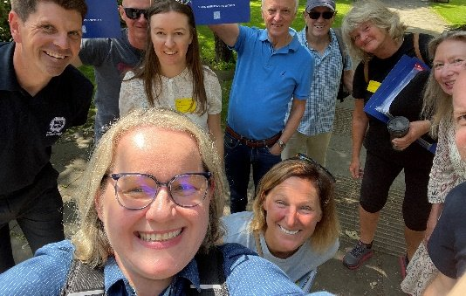
What we’re trying to do :
We want key groups in and around Littlestone to understand what’s being done to look after the bathing water and to feel confident that progress is being made. The aim is to
Inform of roles and responsibilities
keep people informed of efforts in the local area
Work together and tap into local knowledge
Make it easier for the community to help keep the beach and water healthy.
Outcomes
Clear, simple updates people can trust
Joined‑up messages across councils, EA, RNLI and community groups
Visible progress on actions that support bathing water improvements
Strong relationships that help the community stay involved

Slide 18
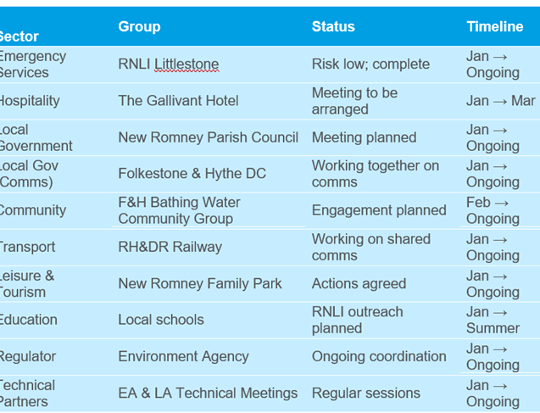
What’s coming next
Site visit took place to New Romne WTW with EA, FHDC, Internal Drainage Board on Friday 30th Jan
Continued engagement with the Folkestone & Hythe technical group
Decision around electronic PRF signage proposal expected in early Feb.
Support RNLI school sessions in spring/summer Contributed £50k
Prepare visitor information for Easter and summer
Who We’re Speaking To

Slide 19
Bathing Water investigations

Slide 20
Investigation highlights
Dymchurch WTW improvements. Continued monitoring of the performance ahead of improvements planned to start in 2026
Sewer rehab programme Folkestone. Repairs completed on Hasborough Rd, Wear Bay Crescent, Sussex Road. Repair booked on Blackbull Road
CCTV investigations are ongoing in Dymchurch, Review of surveys
Littlestone Deep dive complete, site visits complete, comprehensive sampling programme in development and CCTV investigations due to commence
Visit to Coast Drive Wastewater Pumping Station (WPS) and the vacuum system serving Greatstone
Greatstone unconnected property site visit completed with Folkestone & Hythe officers. Discussions ongoing with EA and FHDC
Surface water monitoring Pilot. Locations scoped to monitor surface water outfalls that discharge into the
Continued collaboration with Folkestone & Hythe council and Environment Agency

Slide 21
Bathing water investigations Folkestone & Hythe
Dymchurch
St Mary’s Bay
Sewer lining complete on domestic property, Lyndhurst Road​
5 wrongly connected properties identified between 2020 and 2023​
Holiday Parks drainage checked​
Sediment sampling completed in the river​
Dymchurch WTW improvements
90 meters of sewer lining completed on Dymchurch High Street foul sewers
CCTV surveys under review with scope to build repair plan where required
Illegal Connections survey of the surface water catchment completed
5 wrongly connected properties identified between 2019 and 2023
Rising main from Taylor’s Lane WPS pressure tested to identify any leaks – none found
APEM investigations – Catchment study completed (including sediment sample taken from the New Sewer)
Sewer lining has taken place
Ongoing monitoring of the New Sewer
Littlestone
Continued investigations to check cess pits and where possible, connect to mains drainage
Working with Folkestone & Hythe council & EA to progress
Coast Drive WPS & Vacuum system site visit to understand capacity to connect more properties
Plans in development to focus attention on the ground investigations, Sampling of ditch network ,Water stream of New Romney WTW and Victoria road development.
Folkestone – Sunny Sands
Illegal Connections team survey of the surface water catchment ongoing.​
3 properties identified having household waste connected to the surface water system. All resolved
Sewer rehabilitation has started. Repair complete in The Bayle, Fairway Avenue, Harbour Way, Hasborough Rd, Wear Bay Crescent, Sussex Road.
Folkestone & Hythe District Council and the Environment Agency will gain access to the Harbour Arm to confirm that all toilet facilities are correctly connected and to identify any potential issues.
21
21
Notes:
Read more in the bathing water report

Slide 22
Appendix
EA Investigatory Sample Data: Geomeans and 90th Percentiles 2025
Shadow Sample Locations
Elevated Shadow Sample Results: Littlestone, Dymchurch, St Mary’s Bay and Folkestone

Slide 23
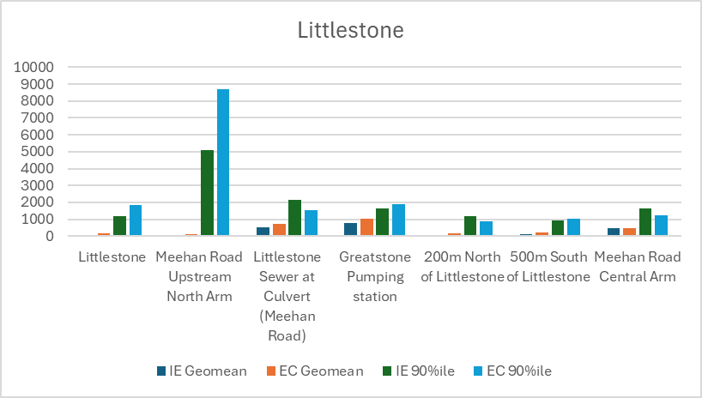
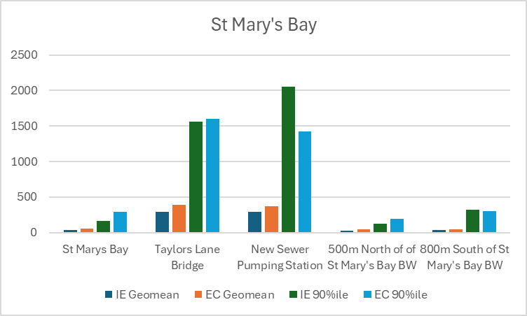
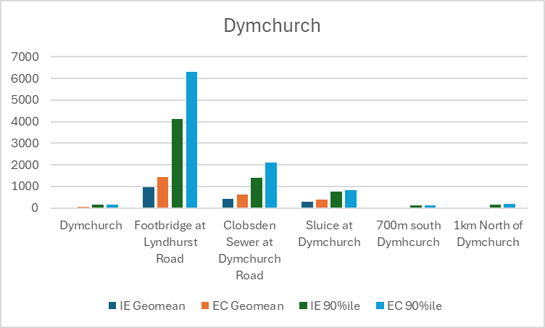
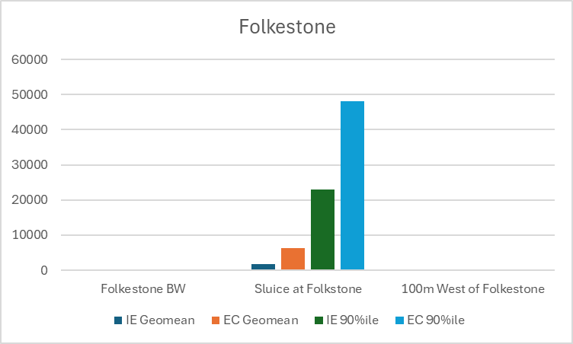
EA Investigatory Sample Data: Geomeans and 90th Percentiles 2025
The below charts show the geomean and 90th percentile for Intestinal Enterococci and e.Coli results from EA Investigatory sample results across the Bathing water season
Sandgate and Hythe have not been included as there are no EA investigatory sample results available

Slide 24
Shadow Sample Locations
Dymchurch | Location/Description | Easting | Northing | Littlestone | Location/Description | Easting | Northing | Folkestone | Location/Description | Easting | Northing | St Mary's Bay | Location/Description | Easting | Northing
DYMCS01 | On beach behind 3 Seaview Heights, High St | 610370 | 129450 | LITCS01 | Outside 17 Coast Drive | 608239 | 123115 | FOLCS01 | on beach by Hotel Burstin | 623270 | 135848 | STMCS01 | Just offshore rock armour | 609182 | 127226
DYMCS02 | Designated sample point. On beach behind MrT's Amusements | 610240 | 129300 | LITCS02 | Outside RNLI Littlestone Station | 608363 | 123653 | FOLCS02† | junction Harbour Rd & Harbour Approach Rd | 623216 | 135946 | STMCS02 | 230m offshore at end of marked outfall | 609264 | 127364
DYMCS03 | On beach behind Ocean Inn, High St. | 610130 | 129160 | LITCS03 | Junction of Clark Rd/Coast Dr | 608400 | 123900 | FOLCS03 | on beach by Royal George | 623277 | 135990 | STMCS03 | Inline with No. 2 | 609214 | 127466
DYMCS04 | On beach at the mouth of Hoorne's Sewer | 610100 | 129050 | LITCS04 | Junction of Grand Parade/Victoria Rd | 608453 | 124144 | FOLCS04 | 100m east of Sunny Sands | 623615 | 136249 | STMCS04 | Infront of No. 71 | 609300 | 127700
DYMRV01 | Clobsden Sewer at 155 Fairway | 609498 | 128247 | LITCS05 | In front of Mulberry House | 608556 | 124697 | FOLCS05 | junction Wear Bay Rd and Varne Pl | 623874 | 136341 | STMCS05 | Behind No. 87 | 609396 | 127931
DYMRV02 | Marshland Sewer at 30 Eastbridge Road | 609650 | 129753 | LITCS06 | Near Greatstone Beach Car Park | 608225 | 122768 | FOLRIV1 | Pent stream by junction Black Bull Road with Foord Road | 622665 | 136602 | STMRIV1† | Environment Agency cmpd | 609015 | 127275
DYMRV03 | Hoorne’s Sewer at 35 Tower Estate | 611518 | 130814 | LITCS07 | End of Sea View Road | 608236 | 122208 | FOLRIV2 | Bridge over Pent stream south of Goldwyn Brook School | 622298 | 136731 | STMRIV2 | in river by No. 35 | 608890 | 127250
DYMRV04 | EA site of Dymchurch Road (Hoorne Sewer discharge point) | 610056 | 129137 | LITRV01 | Off Meehan Road (EA site) | 608188 | 123701 | FOLRIV3 | Pent Stream west of Royal Victoria Hospital | 622166 | 136703 | STMRIV3 | in river by No. 57 | 608790 | 127210
 |  |  |  | LITRV02 | By 95 Meehan Road | 608146 | 123867 | FOLRIV4 | Pent Stream 100m north No. 28 | 621664 | 136849 | STMRIV4 | in river by No. 4 | 608630 | 127160
 |  |  |  | LITRV03 | At Entrance to New Romney Caravan Park | 608128 | 123958 | FOLRIV5 | Pent Stream by No. 41 | 621429 | 137017 | STMRIV5 | in river at Taylor's Lane Bridge | 608540 | 127130
 |  |  |  | LITRV04 | Within New Romney Caravan Park | 607920 | 124020 | FOLRIV6 | Ditch behind No. 17 | 620960 | 136950 | STMRIV6 | In river at the bridge at The Fairway | 609490 | 128240
 |  |  |  | LITRV05 | In fields behind 35 Meehan Road | 607951 | 123760 | FOLRIV7 | Pent Stream by No. 51 | 620927 | 137307

Slide 25
Shadow Sample Data: Dymchurch 2025 (elevated samples)
Sample site | Sample number | Date | Weather | Sample time | Time collected | Water Temp | Tide | Flow in outfall | Bottled sample ref | Ecoli result | IE results | Above Excellent? | Comments | Spill? | Rain total 5 days prior (mm) | HW time | Time to HW | Flow from
 | DYMCS01-12 | 05/08/2025 | Dry | 05/08/2025 10:34 | 10:34 | 16.5 | Mid high tide | No | 9155200 | 340 | 70 | Yes |  | No Spill | 0 | 05/08/2025 09:00 | 1.57 | West
 | DYMCS02-02 | 06/02/2025 | Light rain | 06/02/2025 12:43 | 12:43 | 5 | Mid low tide | Yes | 8810085 | 300 | 68 | Yes | Shoreside due to stormy conditions | No Spill | 0.4 | 06/02/2025 17:05 | -4.37 | East
 | DYMCS02-09 | 19/06/2025 | Sunny | 19/06/2025 10:22 | 10:22 | 18 | Low tide | Yes | 9061784 | 140 | 410 | Yes | Point visited during an active pollution attendance | No Spill | 0 | 19/06/2025 05:29 | 4.88 | North East
 | DYMCS02-11 | 15/07/2025 | Sunny | 15/07/2025 09:52 | 09:52 | 16 | Low tide | Yes | 9114700 | 100 | 140 | Yes |  | No Spill | 0 | 15/07/2025 14:53 | -5.02 | East
 | DYMCS02-12 | 05/08/2025 | Dry | 05/08/2025 10:39 | 10:39 | 16.5 | Mid high tide | No | 9155201 | 450 | 80 | Yes |  | No Spill | 0 | 05/08/2025 09:00 | 1.65 | West
 | DYMCS02-13 | 02/09/2025 | Light rain | 02/09/2025 10:49 | 10:49 |  | Mid high tide | Yes | 9209936 | 100 | 300 | Yes |  | No Spill | 22 | 02/09/2025 07:14 | 3.58 | Slack
 | DYMCS02-15 | 19/09/2025 | Light rain | 19/09/2025 10:31 | 10:31 |  | High tide | No | 9244104 | 100 | 150 | Yes |  | No Spill | 1.4 | 19/09/2025 10:37 | -0.10 | West
 | DYMCS03-11 | 15/07/2025 | Sunny | 15/07/2025 09:59 | 09:59 | 16 | Low tide | Yes | 9114701 | 900 | 1000 | Yes |  | No Spill | 0 | 15/07/2025 14:53 | -4.90 | East
 | DYMCS03-12 | 05/08/2025 | Dry | 05/08/2025 10:44 | 10:44 | 16.5 | Mid high tide | No | 9155202 | 420 | 40 | Yes |  | No Spill | 0 | 05/08/2025 09:00 | 1.73 | West
 | DYMCS03-13 | 02/09/2025 | Light rain | 02/09/2025 10:35 | 10:35 |  | Mid high tide | Yes | 9209937 | 4000 | 6200 | Yes | In-situ data not yet available | No Spill | 22 | 02/09/2025 07:14 | 3.35 | South West
Coastal | DYMCS04-02 | 06/02/2025 | Light rain | 06/02/2025 12:26 | 12:26 | 5 | Mid low tide | Yes | 8810087 | 100 | 500 | Yes | Shoreside due to stormy conditions. | No Spill | 0.4 | 06/02/2025 17:05 | -4.65 | East
 | DYMCS04-09 | 19/06/2025 | Sunny | 19/06/2025 09:57 | 09:57 | 18 | Low tide | Yes | 9061783 | 300 | 28 | Yes | Point visited during an active pollution attendance | No Spill | 0 | 19/06/2025 05:29 | 4.47 | Slack
 | DYMCS04-10 | 20/06/2025 | Sunny | 20/06/2025 12:43 | 12:43 | 19 | Low tide | Yes | 9030391 | 200 | 200 | Yes | Point visited during an active pollution attendance | No Spill | 0 | 20/06/2025 19:06 | -6.38 | East
 | DYMCS04-11 | 15/07/2025 | Sunny | 15/07/2025 10:02 | 10:02 | 16 | Low tide | Yes | 9114702 | 700 | 350 | Yes |  | No Spill | 0 | 15/07/2025 14:53 | -4.85 | East
 | DYMCS04-13 | 02/09/2025 | Light rain | 02/09/2025 10:26 | 10:26 |  | Mid high tide | Yes | 9209938 | 60 | 200 | yes |  | No Spill | 22 | 02/09/2025 07:14 | 3.20 | South West
 | DYMCS04-15 | 19/09/2025 | Light rain | 19/09/2025 10:21 | 10:21 |  | High tide | No | 9244106 | 200 | 55 | Yes |  | No Spill | 1.4 | 19/09/2025 10:37 | -0.27 | West
Outfall | DYMCS04-O-02 | 06/02/2025 | Light rain | 06/02/2025 12:31 | 12:31 | 5 | Mid low tide | Yes | 8810088 | 430 | 530 | Yes | Outfall sampled | No Spill | 0.4 | 06/02/2025 17:05 | -4.57 | East
 | DYMCS04-O-09 | 19/06/2025 | Sunny | 19/06/2025 10:10 | 10:10 | 18 | Low tide | Yes | 9061782 | 2000 | 440 | Yes | Point visited during an active pollution attendance | No Spill | 0 | 19/06/2025 05:29 | 4.68 | North East
 | DYMCS04-O-10 | 20/06/2025 | Sunny | 20/06/2025 12:55 | 12:55 | 19 | Low tide | Yes | 9030390 | 1300 | 780 | Yes | Point visited during an active pollution attendance | No Spill | 0 | 20/06/2025 19:06 | -6.18 | East
 | DYMCS04-O-11 | 15/07/2025 | Sunny | 15/07/2025 10:08 | 10:08 | 16 | Low tide | Yes | 9114703 | 4600 | 1400 | Yes |  | No Spill | 0 | 15/07/2025 14:53 | -4.75 | East
 | DYMCS04-O-13 | 02/09/2025 | Light rain | 02/09/2025 10:31 | 10:31 |  | Mid high tide | Yes | 9209939 | 6200 | 10000 | Yes |  | No Spill | 22 | 02/09/2025 07:14 | 3.28 | South West
 | DYMRV01-15 | 19/09/2025 | Light rain | 19/09/2025 09:51 | 09:51 |  | High tide | No | 9244100 | 310 | 360 | Yes |  | No Spill | 1.4 | 19/09/2025 10:37 | -0.77 | West
 | DYMRV02-15 | 19/09/2025 | Light rain | 19/09/2025 10:51 | 10:51 |  | High tide | No | 9244101 | 200 | 13 | Yes |  | No Spill | 1.4 | 19/09/2025 10:37 | 0.23 | West
 | DYMRV03-15 | 19/09/2025 | Light rain | 19/09/2025 11:07 | 11:07 |  | High tide | No | 9244102 | 270 | 71 | Yes |  | No Spill | 1.4 | 19/09/2025 10:37 | 0.50 | West

Slide 26
Shadow Sampling: Littlestone 2025 (elevated samples)
Sample site | Sample number | Date | Sample time | Weather | Time collected | Water Temp | Tide | Flow in outfall | Bottled sample ref | Ecoli result | IE results | Above Excellent? | Comments | Spill? | Rain? | HW time | Time to HW | Flow from
LITCS01 | LITCS01-01 | 13/01/2025 | 13/01/2025 12:14 | Sunny | 12:14 | 4.5 | High tide | Yes | 8761848 | 290 | 280 | Yes |  | No Spill | 9.2mm (08-13/01) | 13/01/2025 10:39 | 1.58 | South West
 | LITCS01-02 | 31/01/2025 | 31/01/2025 12:03 | Light rain | 12:03 | 6 | High tide | Yes | 8796773 | 70 | 180 | Yes |  | No Spill | 23mm (26-31/01) | 31/01/2025 12:13 | -0.17 | South West
 | LITCS01-08 | 05/09/2025 | 05/09/2025 10:34 | Sunny | 10:34 | 18 | High tide | No | 9217566 | 600 | 180 | Yes | Lots of yellow/white sea foam along shoreline from recent stormy weather. | No Spill | 30.6mm (01-05/09) | 05/09/2025 10:16 | 0.30 | South West
 | LITCS02-02 | 31/01/2025 | 31/01/2025 11:33 | Light rain | 11:33 | 6 | High tide | Yes | 8796774 | 300 | 290 | Yes |  | No Spill | 23mm (26-31/01) | 31/01/2025 12:13 | -0.67 | South West
 | LITCS02-06 | 14/03/2025 | 14/03/2025 09:42 | Sunny | 09:42 | 11 | High tide | No | 8879350 | 170 | 48 | Yes |  | No Spill | 0.8mm (04-09/03) | 14/03/2025 11:35 | -1.88 | Slack
 | LITCS02-08 | 05/09/2025 | 05/09/2025 10:49 | Sunny | 10:49 | 18 | High tide | No | 9217567 | 300 | 280 | Yes |  | No Spill | 30.6mm (01-05/09) | 05/09/2025 10:16 | 0.55 | South West
LITCS03 | LITCS03-01 | 13/01/2025 | 13/01/2025 11:16 | Sunny | 11:16 | 4.5 | High tide | Yes | 8761850 | 1100 | 130 | Yes |  | No Spill | 9.2mm (08-13/01) | 13/01/2025 10:39 | 0.62 | South West
 | LITCS03-08 | 05/09/2025 | 05/09/2025 10:55 | Sunny | 10:55 | 18 | High tide | No | 9217568 | 100 | 210 | Yes |  | No Spill | 30.6mm (01-05/09) | 05/09/2025 10:16 | 0.65 | South West
 | LITCS04-07 | 09/06/2025 | 09/06/2025 10:39 | Dry | 10:39 | 10 | Mid high tide | No | 9042562 | 300 | 45 | Yes |  | No Spill | 16.8mm (04 - 09/06 | 09/06/2025 10:56 | -0.28 | South West
 | LITCS04-08 | 05/09/2025 | 05/09/2025 11:02 | Sunny | 11:02 | 18 | High tide | No | 9217569 | 320 | 180 | yes |  | No Spill | 30.6mm (01-05/09) | 05/09/2025 10:16 | 0.77 | South West
 | LITCS05-02 | 31/01/2025 | 31/01/2025 10:55 | Light rain | 10:55 | 5 | High tide | Yes | 8796777 | 100 | 120 | Yes |  | No Spill | 23mm (26-31/01) | 31/01/2025 12:13 | -1.30 | South West
 | LITCS05-08 | 05/09/2025 | 05/09/2025 09:37 | Sunny | 09:37 | 18 | High tide | No | 9217570 | 100 | 170 | yes |  | No Spill | 30.6mm (01-05/09) | 05/09/2025 10:16 | -0.65 | South West
LITCS06 | LITCS06-01 | 05/09/2025 | 05/09/2025 10:28 | Sunny | 10:28 | 18 | High tide | No | 9217571 | 200 | 240 | yes | Lots of yellow/white sea foam along shoreline from recent stormy weather. | No Spill | 30.6mm (01-05/09) | 05/09/2025 10:16 | 0.20 | South West
LITCS07 | LITCS07-01 | 05/09/2025 | 05/09/2025 10:18 | Sunny | 10:18 | 18 | High tide | No | 9217572 | 400 | 680 | yes | Lots of yellow/white sea foam along shoreline from recent stormy weather. | No Spill | 30.6mm (01-05/09) | 05/09/2025 10:16 | 0.03 | South West

Slide 27
Shadow Sampling: St Mary’s Bay 2025 (elevated samples)
Sample site | Sample number | Date | Weather | Sample time | Time collected | Water Temp | Tide | Flow in outfall | Bottled sample ref | Ecoli result | IE results | Above Excellent | Comments | Spill? | Rain? | HW time | Time to HW | Flow from
 | STMCS01-04 | 14/02/2025 | Sunny | 14/02/2025 11:08 | 11:08 | 4.5 | High tide | No | 8823954 | 40 | 140 | Yes | Shore side sampling due to choppy waves | No spill | 16mm (09-14/02) | 14/02/2025 12:28 | -1.33 | South West
 | STMCS01-06 | 07/03/2025 | Sunny | 07/03/2025 10:52 | 10:52 | 9 | Low tide | Yes | 8863886 | 50 | 130 | Yes |  | No spill | 0.4mm (02-07/03) | 07/03/2025 16:41 | -5.82 | North East
 | STMCS01-08 | 21/03/2025 | Dry | 21/03/2025 10:39 | 10:39 | 10 | Mid low tide | Yes | 8892579 | 200 | 30 | Yes |  | No spill | 0.4mm (16-21/03) | 21/03/2025 14:35 | -3.93 | North East
 | STMCS01-10 | 01/08/2025 | Sunny | 01/08/2025 12:45 | 12:45 | 16 | Mid low tide | Yes | 9149826 | 410 | 1000 | Yes |  | No spill | 4.2mm (27/07-01/08) | 01/08/2025 16:54 | -4.15 | North East
 | STMCS02-08 | 21/03/2025 | Dry | 21/03/2025 10:31 | 10:31 | 10 | Mid low tide | Yes | 8892580 | 150 | 320 | Yes |  | No spill | 0.4mm (16-21/03) | 21/03/2025 14:35 | -4.07 | North East
 | STMCS02-10 | 01/08/2025 | Sunny | 01/08/2025 12:48 | 12:48 | 16 | Mid low tide | Yes | 9149827 | 560 | 450 | Yes |  | No spill | 4.2mm (27/07-01/08) | 01/08/2025 16:54 | -4.10 | North East
 | STMCS03-10 | 01/08/2025 | Sunny | 01/08/2025 12:51 | 12:51 | 16 | Mid low tide | Yes | 9149828 | 200 | 510 | Yes |  | No spill | 4.2mm (27/07-01/08) | 01/08/2025 16:54 | -4.05 | North East
 | STMCS04-04 | 14/02/2025 | Sunny | 14/02/2025 11:25 | 11:25 | 4.5 | High tide | No | 8823957 | 200 | 120 | Yes | Shore side sampling due to choppy waves | No spill | 16mm (09-14/02) | 14/02/2025 12:28 | -1.05 | South West
 | STMCS05-02 | 30/01/2025 | Dry | 30/01/2025 12:01 | 12:01 | 6 | High tide | Yes | 8794401 | 600 | 51 | Yes | Shore side sampling due to choppy waves | 1 spill. Hamstreet 27/01 1 hr 26 mins | 21.6mm (25-30/01) | 30/01/2025 11:34 | 0.45 | South West

Slide 28
Shadow Sampling: Folkestone 2025 (elevated samples)
Sample site | Sample number | Date | Sample time | Weather | Time collected | Water Temp | Tide | Flow in outfall | Bottled sample ref | Ecoli result | IE results | Above Excellent? | Comments | Spill? | Rain? | HW time | Time to HW | Flow from
 | FOLRIV1-04 | 12/02/2025 | 12/02/2025 11:06 | Dry | 11:06 | 7.5 | High | No | 8819695 | 30 | 10000 | Yes |  | No spill | 28.mm (07- 12/02) | 12/02/2025 11:23 | -0.28 | South West
 | FOLRIV1-05 | 27/02/2025 | 27/02/2025 10:49 | Dry | 10:49 | 7.5 | High tide | No | 8847105 | 10000 | 1400 | Yes |  | 2 x Spills. The Stade Folkestone 22/02 3hrs 15 mins, 2 hrs 33 mins | 33mm (22-27/02) | 27/02/2025 10:37 | 0.20 | South West
 | FOLRIV3-05 | 27/02/2025 | 27/02/2025 12:12 | Dry | 12:12 | 8.5 | High tide | No | 8847107 | 10000 | 1300 | Yes |  | 2 x Spills. The Stade Folkestone 22/02 3hrs 15 mins, 2 hrs 33 mins | 33mm (22-27/02) | 27/02/2025 10:37 | 1.58 | South West
 | FOLCS01-05 | 27/02/2025 | 27/02/2025 11:14 | Dry | 11:14 | 7.5 | High tide | No | 8847100 | 100 | 140 | Yes |  | 2 x Spills. The Stade Folkestone 22/02 3hrs 15 mins, 2 hrs 33 mins | 33mm (22-27/02) | 27/02/2025 10:37 | 0.62 | South West
 | FOLCS01-10 | 15/05/2025 | 15/05/2025 12:32 | Sunny | 12:32 | 13.5 | High tide | No | 8996962 | 400 | 690 | Yes | In situ data and sample result to be added when available | No spill | No rainfall | 15/05/2025 13:24 | -0.87 | South West
 | FOLCS02†-05 | 27/02/2025 | 27/02/2025 11:17 | Dry | 11:17 | 7.5 | High tide | No | 8847101 | 100 | 110 | Yes |  | 2 x Spills. The Stade Folkestone 22/02 3hrs 15 mins, 2 hrs 33 mins | 33mm (22-27/02) | 27/02/2025 10:37 | 0.67 | South West
 | FOLCS02†-07 | 17/03/2025 | 17/03/2025 12:34 | Sunny | 12:34 | 8 | High tide | No | 8884581 | 100 | 500 | Yes |  | No spill | 3.5 mm (14-17/03) | 17/03/2025 12:56 | -0.37 | South West
 | FOLCS02†-10 | 15/05/2025 | 15/05/2025 12:26 | Sunny | 12:26 | 13.5 | High tide | No | 8996963 | 200 | 180 | Yes |  | No spill | No rainfall | 15/05/2025 13:24 | -0.97 | South West
 | FOLCS04-03 | 03/02/2025 | 03/02/2025 12:13 | Dry | 12:13 | 9 | Low | No | 8802508 | 100 | 260 | Yes |  | No spill | 9.6mm (29/01-03/02) | 03/02/2025 14:15 | -2.03 | Slack
 | FOLCS04-04 | 12/02/2025 | 12/02/2025 11:52 | Dry | 11:52 | 7 | High | No | 8819702 | 21 | 190 | Yes | Shoreside as high tide covers entire beach | No spill | 28.mm (07- 12/02) | 12/02/2025 11:23 | 0.48 | South West
 | FOLCS04-05 | 27/02/2025 | 27/02/2025 11:31 | Dry | 11:31 | 7.5 | High tide | No | 8847103 | 40 | 180 | Yes |  | 2 x Spills. The Stade Folkestone 22/02 3hrs 15 mins, 2 hrs 33 mins | 33mm (22-27/02) | 27/02/2025 10:37 | 0.90 | South West

